Slide 1
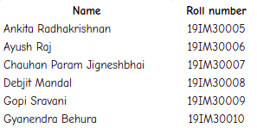
Case Study
Analysis of the financial performance of Walmart

Slide 2
HOW Walmart BEGAN
Sam Walton’s goals for great value and great customer service.
True leadership depends on willing service.
Competitive strategy - One-stop shopping and EDLP (Everyday Low Prices)
5 main types of Walmart stores:
Supercenters - largest, an average area of 180,000 sq ft
Discount stores
Neighbourhood markets and other smaller formats
Sam’s club - an annual renewable membership, bulk quantities of merchandise, their customer segment has professional purposes.
Gas stations/convenience stores
Walmart replaces cash registers with computerized point-of-sale system
Walmart crosses annual sales of 400 billion dollars for the first time
Walmart store is born
1962
1980
1983
2007
2009
2010
Walmart reached 1 billion in annual sales
Walmart.com launches its site to store service
Bharti Walmart a joint venture open its first store in INDIA

Slide 3
Some of the salient features of its supply chain strategy
The supply chain department of Walmart keeps track of the demand of each product, tracking their movement from other stores as well, which defines which region requires which sort of product in which amount.
This makes use of a very effective information system that secures all sort of transits and transactions. This analyses the sales, trend of customers in reference to market information and acts as an effective intermediate between the distributors and the wholesale dealers (information as a SC driver).
Walmart’s supply chain management strategy has provided the company with several sustainable competitive advantages, including lower product costs, reduced inventory carrying costs, improved in-store variety and selection, and highly competitive pricing for the consumer (pricing as a SC tactic).
They have not taken any big step to change the pattern of the retail sector, unlike Amazon. They are ‘happy’ with short term goals and acquisitions around the globe.

Slide 4
^{Vendor Managed Inventory}
Walmart uses a VMI in which suppliers take care of their products within a retailer’s inventory.
Established strategic partnerships with most of their vendors ,offering them the potential for long-term and high volume purchases in exchange for the lowest possible prices.
Strategic Vendor Partnership
Some of the technology that walmart used were Barcodes, RFID etc. They also made use of collaborations with other organizations.
Technology
Cross-Docking as
an Inventory Tactic
Goods will cross from one loading dock to another, usually in 24 hours or less, and company trucks that would otherwise return empty “backhaul” unsold merchandise.
One of its functions is to be a warehouse and the other function is to serve as a cross docking facility where products flow through to stores without being warehoused.
Distribution Centres

Slide 5
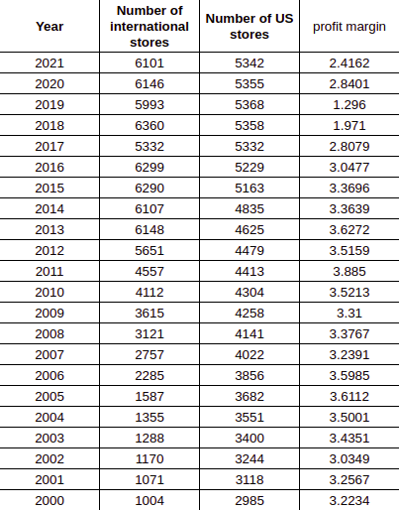
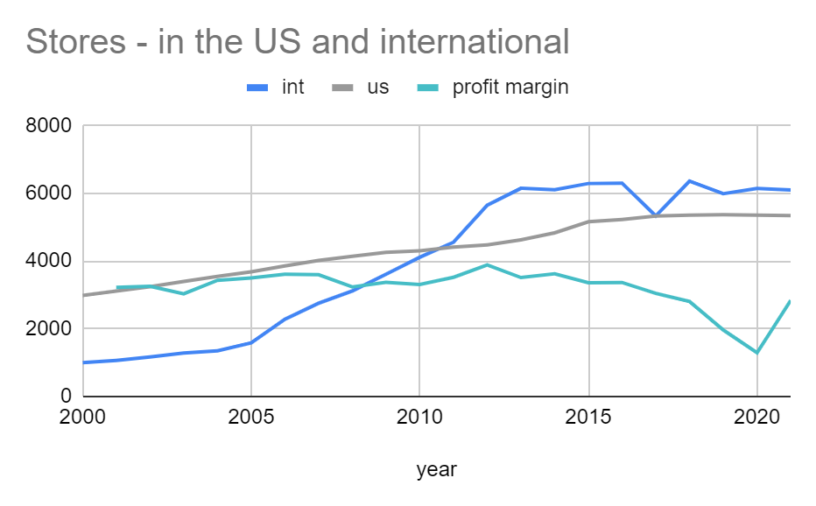
CHALLENGES TO Walmart’S SUPPLY CHAIN
The cost of owning trucks, deviation from their competency, higher pay, inventory management issues
Problems in their operating cycle
^{Just in Time (JIT)}
^{Intense investments in IT}
Failure on an international level - Cultural issues have affected the company at large and they had to even merge with local retailers to be in the business or leave the country.

Slide 6
Walmart -Bharti Joint venture
The Bharti Enterprises of India, a premier business conglomerate in India, and Walmart of U.S.A., the largest retailer in the world, made a historic partnership agreement to operate wholesale cash and carry stores in India. The joint venture, however, lasted only for a few years before they cancelled it.
A successful functioning of a joint venture requires that the partners clearly define its goals, clearly spell out their respective responsibilities to accomplish these goals, and carry out those responsibilities. A joint venture’s success or failure depends not only upon the partners accomplishing these goals and carrying out these responsibilities, but also on the socio-economic and political variables beyond their control.
So, when on October 9, 2012, Walmart and Bharti announced the breakup of their dream team and decided to go separate ways in both retail and wholesale ventures, people wondered why.
Reasons behind the failure of Walmart - Bharti joint venture :
High competition
India’s FDI (Foreign Direct Investment) retailing laws
Terms and conditions of Joint venture
Politics and corruption

Slide 7
SWOT ANALYSIS
“50% of Walmart’s customers chose
“low pricing” and 32% of their customers chose “broad selection of items” and “convenience” as the reason why they shop at Walmart. 50% of Walmart’s customers come from families with an annual income less than $30,000, whereas only 33% of the customers have an annual income of more than $50,000.”
(Princeton Survey Research Associates International, 2005)
Strengths
Weaknesses
Opportunities
Threats
Large company size
EDLP
Suppliers
Private truck fleet for deliveries;
Strong leadership
Transparency
Successful vendor partnerships
Automating their supply chain
Largest retailer wrt revenue/private employment
Did not try to revolutionize Faced a lot of opposition Questionable labour practices Accused of bribery Poor working conditions Employing illegal immigrants Loss of reputation Unable to expand into metropolitan cities
Ability to procure items Open to improving Superior to smaller retailers and Foreign markets. Third principal US corporate user of green power Expansion online
Online e-commerce like Amazon
Threat of digitalization International barrier threats Government policies Market saturation Cannibalization
Loss of Cost effectiveness advantage
Other companies are catching up

Slide 8
Financial Analysis
Horizontal Analysis - Horizontal analysis is used in the review of a company's financial statements over multiple periods. We compared the percentage change in total revenue with the percentage change in total operating expenses for every year from 2005-2021.
In 2004, they decreased their total expense by 32.8 percent but their revenue increased by 9.9 percent.
They started implementing RFID in 2003 and that was officially completed by 2005, so this could be a sign of those times.
The pandemic also didn't impact this significantly. Their revenue increased in the same ratio as their expenses. We can note that they increased their expenses by 6 percent which is considerably more than last 8 years. We can say that this significant rise was probably due to Covid. By doing this they managed to generate more revenue than their expenses. This may have been due to their online sales due to covid restrictions.

Slide 9
Horizontal Analysis
Year | Revenue (in millions USD) | % Revenue | Cost of goods sold (in millions USD) | Operating Expenses (in millions USD) | Total expenses (in millions USD) | % Expense
2021 | 559,151 | 6.715537709 | 420,315 | 116,288 | 536,603 | 6.596595921
2020 | 523,964 | 1.858263431 | 394,605 | 108,791 | 503,396 | 2.223178894
2019 | 514,405 | 2.810472016 | 385,301 | 107,147 | 492,448 | 2.613428463
2018 | 500,343 | 2.978144495 | 373,396 | 106,510 | 479,906 | 3.627007897
2017 | 485,873 | 0.7763466285 | 361,256 | 101,853 | 463,109 | 1.10998308
2016 | 482,130 | -0.7250062288 | 360,984 | 97,041 | 458,025 | -0.10447019
2015 | 485,651 | 1.964542908 | 365,086 | 93,418 | 458,504 | 2.02081785
2014 | 476,294 | 1.630851102 | 358,069 | 91,353 | 449,422 | 1.870480767
2013 | 468,651 | 4.958914602 | 352,297 | 88,873 | 441,170 | 4.975990939
2012 | 446,509 | 5.845693601 | 334,993 | 85,265 | 420,258 | 6.043547048
2011 | 421,849 | 3.37282674 | 314,946 | 81,361 | 396,307 | 3.282140558
2010 | 408,085 | 0.9476715135 | 304,106 | 79,607 | 383,713 | 0.5903617932
2009 | 404,254 | 7.222636285 | 303,941 | 77,520 | 381,461 | 7.432316354
2008 | 377,023 | 8.225497175 | 284,137 | 70,934 | 355,071 | 8.259954875
2007 | 348,368 | 11.62027677 | 263,979 | 64,001 | 327,980 | 11.79052995
2006 | 312,101 | 9.774893602 | 237,649 | 55,739 | 293,388 | 9.879030748
2005 | 284,310 | 9.907569555 | 216,832 | 50,178 | 267,010 | -32.82665902
2004 | 258,681 |  | 198,747 | 198747 | 397,494

Slide 10
Vertical Analysis
Vertical analysis is a method of financial statement analysis in which each item is listed as a percentage of the base figure within the statement.
Vertical Analysis (Income Statement)
When performing a Vertical Analysis of an Income Statement, Net Sales usually used as the basis for which all other items are compared.
Year | 2021 | 2020 | 2019 | 2018 | 2017 | 2016
Int sales (in millions USD) | 555233 | 519926 | 514405 | 495760 | 481320 | 478610
Cost of goods sold (in millions USD) | 420,315 | 394,605 | 385,301 | 373,396 | 361,256 | 360,984
Gross Profit (in millions USD) | 138,836 | 129,359 | 129,104 | 126,947 | 124,617 | 120,565
Operating Expenses (in millions USD) | 116,288 | 108,791 | 107,147 | 106,510 | 101,853 | 97,041
COGS (% sales) | 75.7006518 | 75.89637756 | 74.90226572 | 75.31789576 | 75.05526469 | 75.42341364
Gross Profit(% sales) | 25.0049979 | 24.88027142 | 25.09773428 | 25.60654349 | 25.89067564 | 25.19065628
Operating Expenses(% sales) | 20.94400009 | 20.92432385 | 20.82930765 | 21.4841859 | 21.16118175 | 20.27558973

Slide 11
We can see that the Cost of Goods Sold, Gross Profit and Operating Expenses have almost the same fraction of sales over the period from 2016-2021. We can see that their cost of goods sold is around 75 percent of the total sales and their gross profit is around 25 percent.
Vertical Analysis (Balance Sheet)
When creating a Vertical Analysis for a balance sheet, total assets are used as basis for analyzing each asset account.
Year | 2021 | 2020 | 2019
Inventory (in millions USD) | 44,949 | 44,435 | 44,269
Property, Plant, And Equipment (in millions USD) | 92,201 | 105,208 | 104,317
Total Assets (in millions USD) | 252,496 | 236,495 | 219,295
Inventory (%assets) | 18 | 19 | 20
Property, Plant, And Equipment (%assets) | 37 | 44 | 48
We can see that Inventory is around 20 percent of their total assets and Property,Plant and Equipment is around 40 percent of the total assets.

Slide 12
Vertical Analysis is also highly effective while comparing two or more companies working in the same industry.
For the year 2021
US Companies | Walmart | Amazon | e Bay | Costco | Target
Sales | 559151 | 386064 | 10271 | 195929 | 93561
Cost of goods sold | 420315 | 233307 | 2473 | 170684 | 66177
Gross profit | 138836 | 152757 | 7798 | 25245 | 27384
Operating Expenses | 536603 | 363165 | 7560 | 189221 | 87022
Total Assets | 252496 | 321195 | 19310 | 59268 | 51248
Property, plant and equipment | 92201 | 113114 | 1358 | 23492 | 26879
Inventories | 44949 | 23795 | ------- | 14215 | 10653
Cost of goods sold (%sales) | 75.17021341 | 60.43220813 | 24.07749976 | 87.11523052 | 70.73139449
Gross profit (%sales) | 24.82978659 | 39.56779187 | 75.92250024 | 12.88476948 | 29.26860551
Operating Expenses (%sales) | 95.96745781 | 94.06860002 | 73.60529647 | 96.57631081 | 93.0109768
Property, plant and equipment (%assets) | 36.51582599 | 35.21661296 | 7.032625583 | 39.63690356 | 52.44887605
Inventories (%assets) | 17.80186617 | 7.408272233 | ------- | 23.98427482 | 20.78715267

Slide 13
Inferences
By comparing the COGS as a percentage of sales, we can note that percentage is most for Costco, around 87 percent, followed by Walmart. Costco has a low price membership based model, which may explain this and the fees allow you to obtain products of lower prices. This has attracted customers into Costco.
Considering the gross profit as a percentage of sales, we find that the greatest percentage is for eBay (around 80 %). Their asset-light selling approach avoided expensive commitment in areas like manufacturing and shipping which allows them to enjoy a higher profit margin than companies like Amazon. This may also explain while their OE % and PPE % is lower than the other companies.
Costco has the lowest profit percentage of sales at around 13 percent. This is because it tries to keep its customers happy by selling great quality goods at lower prices which means that they tend to cut prices to gain market shares or not increase costs to ensure that it maintains low prices. This often reduces its profit but due to its strong business model, it stays on top of things.
The inventory as a percentage of assets is highest for Costco, which proves that it kept more items in stock so as to meet its demand. Since its membership allowed customers to benefit from bulk purchases once or twice a month, it probably had to have a good reserves of inventory.
The lowest inventory as a percentage of assets is for Amazon, which while did store products in its inventory so as to be able to respond to customer orders, does not require it in the same amount that huge retailers on ground require.
The highest PPE as a percentage of assets is for Target (52%), which means that the greater portion of their assets went in land, building, machinery and equipment. Target is well-established in metropolitan cities, which explains this.

Slide 14







Ratio Analysis
Return on Assets - ROA is an indicator of how efficient or profitable a company is relative to its assets or the resources it owns or controls.
Return on equity - Return on equity (ROE) is a measure of financial performance calculated by dividing net income by shareholders' equity.
Profit Margin - The profit margin is a ratio of a company's profit (sales minus all expenses) divided by its revenue.
Inventory Turnover - Inventory turnover is a financial ratio showing how many times a company has sold and replaced inventory during a given period. This is unaffected by increasing the number of stores.
C2C
Cash to cash cycle (average amount of time when cash enters the process as cost to when it returns as collected revenue)

Slide 15
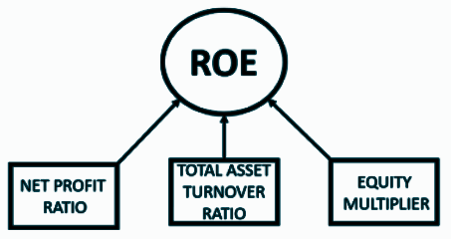
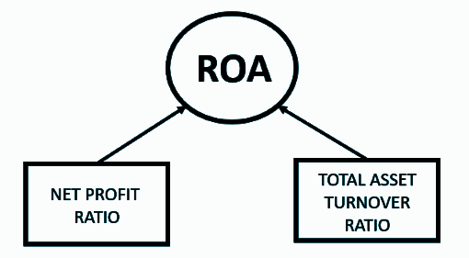
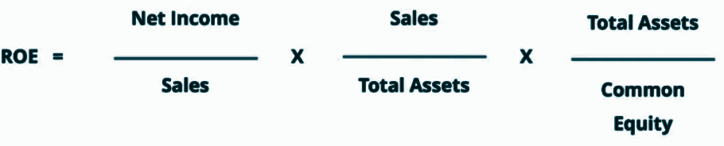
DuPont Analysis
The original equation for ROE can be broken down into three components: operating efficiency, asset efficiency, and leverage. Same for ROA
Operating efficiency is measured by the Net Profit Margin
Asset efficiency is measured by the Total Asset Turnover
Financial leverage is determined by the Equity Multiplier
Data for calculating these 3 metrics was collected from the years 2010 - 2021. We then used ANOVA to find the association among these 3 groups (NPR, TATR and EQM), to see if they independently contribute to the ROE/ROA or whether they are correlated in their contribution.

Slide 16
Calculated metrics for 2010-2021
H₀ = There is no association between two groups
H₁ = There is an association between two groups (H₀ is false)
Year | Net income(in millions USD) | sales (in millions USD) | NPR | Assets (in millions USD) | TATR | Liabilities (in millions USD) | EQM
2021 | 13,510 | 555233 | 2.43 | 252496 | 219.9 | 164965 | 288.46
2020 | 14,881 | 519926 | 2.86 | 236495 | 219.85 | 154943 | 289.99
2019 | 6,670 | 514405 | 1.3 | 219295 | 234.57 | 139661 | 275.38
2018 | 9,862 | 495761 | 1.99 | 204522 | 242.4 | 123700 | 253.05
2017 | 13,643 | 481317 | 2.83 | 198825 | 242.08 | 118290 | 246.88
2016 | 14,694 | 478614 | 3.07 | 199581 | 239.81 | 115970 | 238.7
2015 | 16,363 | 482229 | 3.39 | 203490 | 236.98 | 117553 | 236.79
2014 | 16,022 | 473076 | 3.39 | 204751 | 231.05 | 123412 | 251.73
2013 | 16,999 | 465604 | 3.65 | 203105 | 229.24 | 121367 | 248.48
2012 | 15,699 | 443416 | 3.54 | 193406 | 229.27 | 117645 | 255.28
2011 | 16,389 | 418500 | 3.92 | 180782 | 231.49 | 109535 | 253.74
2010 | 14,370 | 405046 | 3.55 | 170407 | 237.69 | 97759 | 234.57
 |  | MEAN | 2.993333333 |  | 232.8608333 |  | 256.0875
 |  | STDEV | 0.7660445434 |  | 7.603331158 |  | 18.79146185
A company like Walmart which sells goods at lower prices is likely to see high asset turnover but a much smaller profit margin due to the lower prices - this lower value merely points to its commitment to EDLP. The last component, financial leverage, captures the company’s financial activities. The more leverage the company takes, the higher the risk of default.

Slide 17
How to perform ANOVA (taking the example of NPR and TATR)
NPR
2.43
2.86
1.3
1.99
2.83
3.07
3.39
3.39
3.65
3.54
3.92
3.55
Step 1: We need to find the combined mean of the data - which turns out to be 118. Then we need to find the square of the deviation of each reading from the grand mean, for example, (2.43 - 118)² = 13339.57626 and so on.
TATR
219.9
219.85
234.57
242.4
242.08
239.81
236.98
231.05
229.24
229.27
231.49
237.69
 | grand mean | 118
 | ∆NPR | ∆TATR
1 | 13339.57626 | 10398.47573
2 | 13240.43367 | 10388.28094
3 | 13601.87657 | 13605.57001
4 | 13441.40729 | 15493.50698
5 | 13247.33859 | 15413.94672
6 | 13192.14959 | 14855.44538
7 | 13118.74346 | 14173.59697
8 | 13118.74346 | 12796.79428
9 | 13059.25178 | 12390.56542
10 | 13084.40483 | 12397.24509
11 | 12997.61505 | 12896.53604
12 | 13082.11719 | 14343.15621
Step 2:
The sum of the squares of the deviations is the total sum of the squares.
Then the sum of the squares has to be calculated for within the two groups (NPR and TATR), and this is calculated as 11*((standard deviation of NPR)² + (standard deviation of TATR)²) (11 as the number of subgroups is 12, and (n-1)).
 | SS | dof | MSS
total | 317676.7775 | 23 | 13812.0338
within groups | 642.3721583 | 22 | 29.19873447
between groups | 317034.4053 | 1 | 317034.4053
Step 3: The test statistic is calculated as MSS (within groups)/ MSS (between groups), and compared with the standard value Fo - considering a significance level α of .95, and degrees of freedom as 1 and 22, this can be calculated using Excel as =FINV(0.05, 1, 22) which comes out to be around 4.301.
Test statistic (F dist) | Fo
10857.81323 | 4.300949502

Slide 18
ANOVA analysis - one-way test of independence
 | 118 | F(0.05, 1, 22) | 4.300949502 | p | 0.05
NPR and TATR | df | SS | MSS | F-stat | p
Between groups | 1 | 317034.4053 | 317034.4053 | 10857.81323 | 0
Within groups | 22 | 642.3721583 | 29.19873447
Total | 23 | 317676.7775 | 13812.0338 |  | rejected
 | 244.4741667
EQM and TATR | df | SS | MSS | F-stat | p
Between groups | 1 | 3236.868267 | 3236.868267 | 15.75387906 | 0.0006502878602
Within groups | 22 | 4520.226517 | 205.4648417
Total | 23 | 7757.094783 | 337.2649906 |  | rejected
 | 129.5404167
NPR and EQM | df | SS | MSS | F-stat | p
Between groups | 1 | 384339.9432 | 384339.9432 | 2173.217826 | 0
Within groups | 22 | 3890.764492 | 176.8529314
Total | 23 | 388230.7077 | 16879.59599 |  | rejected
We observe that the null hypothesis fails in each case, which proves that the groups are all linked to one another.

Slide 19
Question 01
Evaluate Walmart’s financial performance based on the various metrics discussed in Section 3.1, such as ROE, ROA, profit margin, asset turns, APT, C2C, ART, INVT, and PPET.
Compare the metrics for Walmart with similar metrics for Amazon from Table 3-1.
Which metrics does Amazon perform better on? Which metrics does Walmart perform better on?
What supply chain drivers and metrics might explain this difference in performance?
Walmart |  |  | AMAZON
Year ended January 31 (millions) | 2010 | 2009 | Year ended January 31 (millions) | 2010 | 2009 | 2008
Net operating revenues | 408214 | 404374 | Net operating revenues | 34204 | 24509 | 19166
Cost of goods sold | 304657 | 304056 | Cost of goods sold | 26561 | 18978 | 14896
Gross profit | 103557 | 100318 | Gross profit | 7643 | 5531 | 4270
Selling, general and administrative expense | 79607 | 77520 | Selling, general and administrative expense | 6237 | 4402 | 3428
Operating income | 23950 | 22798 | Operating income | 1406 | 1129 | 842
Interest expense | 2065 | 2184 | Interest expense | 39 | 34 | 71
Other income (loss) net | 181 | 284 | Other income (loss) net | 130 | 66 | 130
Income before income taxes | 22066 | 20898 | Income before income taxes | 1497 | 1161 | 901
Income taxes | 7139 | 7145 | Income taxes | 352 | 253 | 247
Other expenses | 592 | 353
Net income | 14335 | 13400 | Net income | 1152 | 902 | 645

Slide 20
Assets |  |  | Assets
Cash and cash equivalents | 7907 | 7275 | Cash and cash equivalents | 3777 | 3444 | 2769
Short-term investments | 0 | 0 | Short-term investments | 4985 | 2922 | 958
Net receivables | 4144 | 3905 | Net receivables | 1783 | 1260 | 1031
Inventories | 33160 | 34511 | Inventories | 3202 | 2171 | 1399
Total current assets | 48331 | 48949 | Total current assets | 13747 | 9797 | 6157
Property, plant and equipment | 102307 | 95653 | Property, plant and equipment | 2414 | 1290 | 854
Goodwill | 16126 | 15260 | Goodwill | 1349 | 1234 | 438
Other assets | 3942 | 3567 | Other assets | 1265 | 1492 | 705
Total assets | 170706 | 163429 | Total assets | 18797 | 13813 | 8314
Liabilities and stockholder equity |  |  | Liabilities and stockholder equity
Accounts payable | 50550 | 47638 | Accounts payable | 10372 | 7364 | 4687
Short-term debt | 4919 | 7669 | Short-term debt | 0 | 0 | 59
Other current liability | 92 | 83
Total current liability | 55561 | 47638 | Total current liability | 10372 | 7364 | 4746
Long-term debt | 36401 | 34549 | Long-term debt | 0 | 109 | 533
Other liabilities | 7688 | 7808 | Other liabilities | 1561 | 1083 | 363
Total liabilities | 99650 | 97747 | Total liabilities | 11933 | 8556 | 5642
Stockholder equity | 5257 | 2672 | Stockholder equity | 6864 | 5257 | 2672

Slide 21
Walmart
AMAZON
Metric | 2010 | 2009
TAX Rate | 32.3529 | 34.1899
ROA | 9.2158 | 9.0787
ROE | 20.1742 | 20.4013
Profit Margin | 3.8538 | 3.6692
Asset Turnover | 2.3913 | 2.4743
ART | 98.5072 | 103.5529
APT | 6.0268 | 6.3826
INVT | 9.1875 | 8.8104
PPET | 3.9901 | 4.2275
Metric | 2010 | 2009 | 2008
TAX Rate | 23.5137 | 21.7916 | 27.414
ROA | 6.2873 | 6.7226 | 8.3779
ROE | 16.7832 | 17.1581 | 24.1392
Profit Margin | 3.4552 | 3.7888 | 3.6342
Asset Turnover | 1.8197 | 1.7743 | 2.3053
ART | 19.1834 | 19.4516 | 18.5897
APT | 2.5608 | 2.5771 | 3.1782
INVT | 8.2951 | 8.7416 | 10.6476
PPET | 14.169 | 18.9992 | 22.4426
Ans(2): The one metric on which Amazon performed better than Walmart was PPET.
Possible reasons for Walmart outperforming Amazon:
lack of a physical presence
Walmart serves as the primary low-cost retailer for a high contingent of rural poor Americans
one-stop-shop facility is offered by both these retailers
Amazon was more of a privilege to those who are able to access the digital world, and this has restricted its customer segment.
Walmart’s huge distribution network, which also includes a private fleet of trucks for transportation
strategic vendor partnerships, cross-docking, RFID

Slide 22
SUPPLY CHAIN DRIVERS THAT IMPACTED THIS DIFFERENCE
PRICING
Walmart is known for its lower prices and amazon being a digital platform was not accessible by most people and their focus was not reduced prices but customer comfort.
Greater the value of inventory, the more will be the ability of the company to be responsive and maintain a supply chain accordingly. This implies that C2C will decrease for a company which has more inventory, and this can explain the huge difference in these values for Amazon (-11.53) and Walmart (-1.15)
respectively.
INVENTORY
Year | inventory (WM) | inventory (AM)
2012 | 40714 | 6031
2011 | 36437 | 4992
2010 | 32713 | 3202
2009 | 34511 | 2171
2008 | 35159 | 1399
Walmart has begun offering free two-day delivery on all Walmart.com orders over $35. E-commerce has grown from being less than 5% of retail sales in 2010 to being more than 18% by 2020.
Since 2010, the global sales have increased by 800%. Amazon aims to target the grocery segment of Walmart’s products Walmart started an online presence in 2007 with Walmart.com Amazon started a physical presence with small stores in the US.

Slide 23
Question 02
In 2010, Walmart announced that it planned to move into urban areas in the United States by building and operating smaller format stores compared to the large stores it had operated up to that point. Which supply chain metrics will be impacted by this move? How will this move impact the various financial metrics? Why?
Possible reasons why Walmart had to expand to smaller stores:
The recession after 2008 caused Walmart’s market share growth rate to decline
The growth of various e-commerce companies also pressurized Walmart to make more out of its own Walmart.com, where its stores served as pick-up locations. Thus, increasing the number of stores would have encouraged its online retail sales.
The saturation and declining market size of rural and suburban markets
Many grassroots organizations have rebelled against Walmart’s expansion by protesting site openings, lobbying the local governments, raising awareness about their undesirable labour practices and how they completely sweep small businesses off their feet.
There has been a steady decline in their annual sales growth rate from 2005, despite opening a large number of supercenters. Thus, this indicates the poor performance of supercenters, as people no longer preferred them as much.
The decline in rural population may also have been a contributing factor, as supercenters were primarily located outside metropolitan areas.
Cannibalization - as newer stores were set up in places where stores already existed, they siphoned off the sales of the other stores. In 2008, new stores caused a 29% reduction in existing stores, which was a reason for alarm.
The size of an average supercenter is 180,000 square feet, which is unfit for urban spaces given the limited availability and the expense of real estate. This is what sparked the introduction of neighborhood markets in 1998, and also led to their increased number in years to come.
Its low market share in top urban areas (about 24% in the top 10 most populated metropolitan areas)

Slide 24
Which supply chain metrics will be impacted by this move?
In 2010 the number of neighbourhood markets increased by only 5. However, the rate of increase in the number of neighbourhood stores increased from 2011 to 2014 ( by 31 in 2011 , 21 in 2012, 76 in 2013, 121 in 2014). They kept on decreasing the number of discount stores along with this, thus proving that they believed that neighborhood markets were indeed more profitable.
Impact on Supply Chain Metrics
Inventory to sales ratio - This metric measures the amount of inventory for sale in comparison to the actual quantity that is sold, expressed as a ratio. It will help you to adjust your stock in order to ensure high margins and tell you how well your company is dealing with unexpected situations. The lowest value for it was in 2010 and after this in 2011 there was a major jump and the value was fairly constant after a couple of years. Inventory was at its lowest in 2010.
Supply chain costs - Supply chain costs increased with the increase in the number of stores.
On time shipping and fraction of on-time delivery would have improved, at least in those places where they established smaller stores.
Customer order cycle time - It is the measurement of how long it takes to deliver a customer order after the purchase order is received. Increasing the number of stores helped in shifting resources around areas of most activity and hence decreased the customer order cycle time.
Which financial metrics will be impacted by this move?
By observing the values for roa, roe, inventory turnover and profit margin, we can see that the values for 2011 were particularly higher. We ran a regression analysis on Excel to see if the number of stores did indeed have a significant impact on various financial metrics such as ROA, ROE, profit margin and INVT.

Slide 25
Data used for regression
Variables considered - s (number of supercenters), ds (number of discount stores), o (other neighborhood markets), c (number of Sam’s Club outlets), i (number of international outlets), inv (amount in inventory) and size (number of employees).
Year | s | ds | o | c | i | inv (USD m) | size | roa (%) | roe (%) | pm (%) | invt (%)
2021 | 3570 | 374 | 799 | 599 | 6101 | 44,949 | 2,300,000 | 5.4282 | 15.7 | 2.4162 | 9.3509
2020 | 3571 | 376 | 809 | 599 | 6146 | 44,435 | 2,200,000 | 6.4276 | 18.6 | 2.8401 | 8.8805
2019 | 3570 | 386 | 813 | 599 | 5993 | 44,269 | 2,200,000 | 3.2737 | 9 | 1.296 | 8.7036
2018 | 3561 | 400 | 800 | 597 | 6360 | 43,783 | 2,300,000 | 5.1452 | 13 | 1.971 | 8.5283
2017 | 3522 | 415 | 735 | 660 | 5332 | 43,046 | 2,300,000 | 7.1887 | 17.8 | 2.8079 | 8.3923
2016 | 3465 | 442 | 667 | 655 | 6299 | 44,469 | 2,300,000 | 7.5558 | 18 | 3.0477 | 8.1177
2015 | 3407 | 470 | 639 | 647 | 6290 | 45,141 | 2,200,000 | 8.2628 | 19.6 | 3.3696 | 8.0877
2014 | 3288 | 508 | 407 | 632 | 6107 | 44,858 | 2,200,000 | 8.0835 | 20.3 | 3.3639 | 7.9823
2013 | 3158 | 561 | 286 | 620 | 6148 | 43,803 | 2,200,000 | 8.7167 | 21.7 | 3.6272 | 8.0428
2012 | 3029 | 629 | 210 | 611 | 5651 | 40,714 | 2,200,000 | 8.4837 | 21.7 | 3.5159 | 8.228
2011 | 2907 | 708 | 189 | 609 | 4557 | 36,437 | 2,100,000 | 8.8278 | 22.4 | 3.885 | 8.6436
2010 | 2747 | 803 | 158 | 596 | 4112 | 32,713 | 2,100,000 | 8.7802 | 20.6 | 3.5213 | 9.2962
2009 | 2612 | 891 | 153 | 602 | 3615 | 34,511 | 2,100,000 | 8.4036 | 20.5 | 3.31 | 8.8071
2008 | 2447 | 971 | 132 | 591 | 3121 | 35,159 | 2,100,000 | 8.1149 | 20.5 | 3.3767 | 8.0815
2007 | 2256 | 1075 | 112 | 579 | 2757 | 33,685 | 1,900,000 | 8.0409 | 19.8 | 3.2391 | 7.8367
2006 | 1980 | 1209 | 100 | 567 | 2285 | 31,910 | 1,800,000 | 8.2555 | 21.5 | 3.5985 | 7.4475
2005 | 1713 | 1333 | 85 | 551 | 1587 | 29,762 | 1,700,000 | 8.7238 | 21.2 | 3.6112 | 7.2855

Slide 26
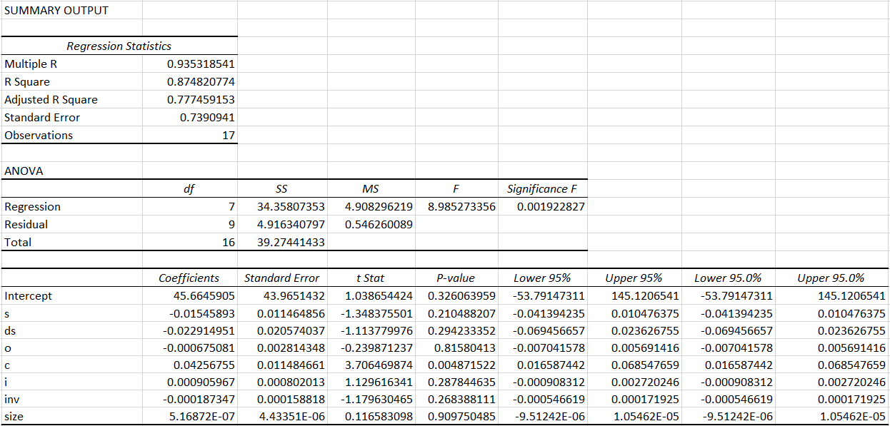
Relevant interpretation of summary output for regression analysis in Excel
Consider the following sample output obtained as a result of regression
ANOVA - We are considering the null hypothesis to be that all the coefficients except the intercept are 0 (no linear relationship exists any of the variables between the variables and Y). If the F statistic value obtained is greater than the significance F, then we can reject this null hypothesis.
Regression coefficients - The p values show the significance of the coefficients, here we have assumed a significance level of 0.10, and if the p-value exceeds 0.10, then it means that that variable does not significantly contribute to the output.

Slide 27
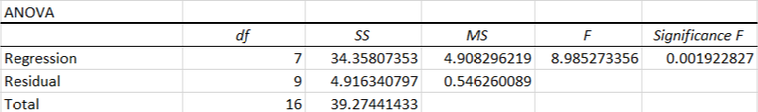
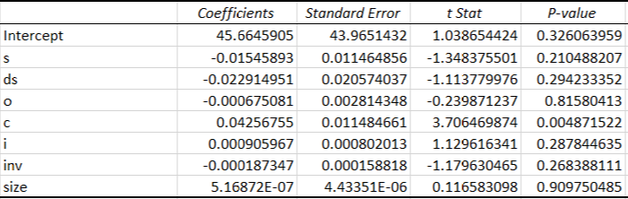
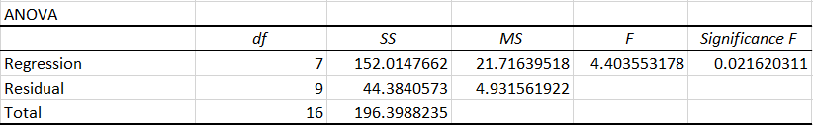
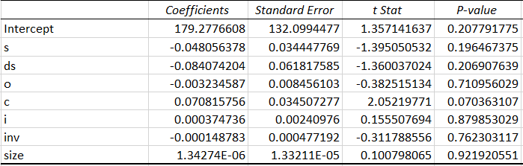
When ROA is taken as the dependent variable - Ho is rejected by ANOVA, and thus some linear relationship exists between atleast one of the independent variables and ROA. However, we find that except for the number of Sam’s Club outlets, none of the others coefficients contribute significantly to ROA.
The same results as obtained for ROA - we reject Ho in ANOVA and the number of Sam’s Clubs come out to be statistically significant.

Slide 28
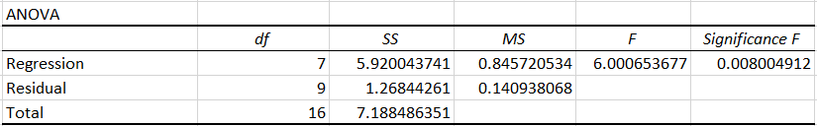
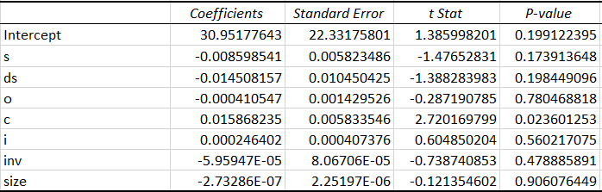
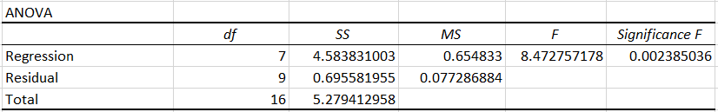
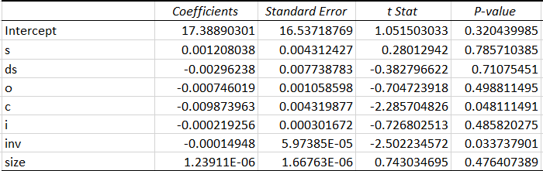
For profit margin, we find have the same results as for ROA - some linear relationship exists, and only the number of Sam’s Club outlets has a significant contribution.
For inventory turnover, Ho is rejected using ANOVA, and both the count of Sam’s Club outlets as well as the inventory (in millions USD) contribute to it.

Slide 29
Conclusions that can be drawn
The increase in the number of neighbourhood markets was with the hope that they would be able to grow. However, as can be understood by observing their financial ratios and also from the above regression analysis done, it can be seen that this did not have the desired impact.
We can note, that in each of the 4 regressions done, the p-value for the coefficient corresponding to the number of other neighbourhood markets is often very high (almost or greater than 0.5 each time). This is further proof that these smaller stores did not help.
One possible explanation for this could be the impact of cannibalization - even though a spurt in these financial ratios was observed in the 2011 reports, it did not last long due to the fact that smaller stores took away sales from neighbouring ones, and also brought down the overall sales due to saturation.
Thus, in order to combat all that threatened their traditional model, Walmart could have tried to focus more on tactics to expand into bigger cities in the United States, or understand the cultural differences or collaborations with local organizations that would have allowed them to become a success on an international level, instead of increasing the number of stores in places they were already well established.
Walmart has not been very successful in cities like New York due to price, competition, and the city’s grid system. The high real estate makes it very expensive to operate their large stores, while Walmart’s wider spread store layouts do not fit into the grid structure of the city. It has also faced opposition from the city’s residents, mostly due to criticism it earned regarding employee pay, working conditions and cutting down on health insurance. However, owing to their purposeful advertising and support of numerous charitable organizations, companies like Target have been successful in the city.

Slide 30
References
50 Years of Walmart’s Supply Chain, by Dan Gilmore (https://www.scdigest.com/ASSETS/FIRSTTHOUGHTS/12-07-26.php?cid=6047)
An Analysis of Current Supply Chain Best Practices in the retail Industry with Case Studies of Walmart and Amazon.com (Colby Ronald Chiles and Marguarette Thi Dau)
An incisive assessment of Walmart’s Supply Chain Management, Adya Verma, Rohit Potluri, Samarth Mahere
Case Study: Wal-Mart’s Distribution and Logistics System, mbaknol.com (https://www.mbaknol.com/management-case-studies/case-study-of-Walmart-logistics-management/)
Dupont Analysis, CFI (https://corporatefinanceinstitute.com/resources/knowledge/finance/dupont-analysis/)
Excel - Horizontal and Vertical Analysis, professoroffice.com (http://professoroffice.com/VerticalHorizontalRatioAnalysis.aspx)
Financial analysis by return on equity (ROE) and return on assets (ROA) - A comparative study of HUL and ITC, Ashok Kumar Panirahi, Kuchal Vachhani
Financial Analysis of retail Business Organization: A Case of Walmart Stores, Inc. (Ascension Barosso Martinez, Ramon Sanguino Galvan, Samsul Alam)
Financial statements of Walmart (https://www.macrotrends.net/stocks/charts/WMT/Walmart/financial-statements)
Smarter demand forecasting using smoothed moving average, quickbooks (https://www.tradegecko.com/blog/inventory-management/smarter-demand-forecasting-using-smoothed-moving-average?_ga=2.248948999.1462940200.1585734433-1340665190.1585734433)
Statista (https://www.statista.com/)
Supply Chain Flexibility is Walmart’s growth key, Supermarket News (https://www.supermarketnews.com/archive/supply-chain-flexibility-Walmarts-growth-key)
Supply Chain Management - Strategy, Planning and Operation - Sunil Chopra and Peter Meindl
SupplyPike report details Walmart’s 2020 inventory issues, The Supply Side (https://talkbusiness.net/2021/04/the-supply-side-supplypike-report-details-Walmarts-2020-inventory-issues/)
SWOT Analysis - Walmart Stores Inc. (Nana Serwaa Ofori-Nyarko, Fuzhong Wang, William Ohene Annoh)
The challenge with Walmart’s IT intensive supply chain, blogspot.com (http://cmuscm.blogspot.com/2013/09/the-challenge-with-Walmarts-it.html)
Walmart annual reports (2000 - 2021)
Walmart’s Limited Growth in Urban Retail Markets: The Cost of Low Labor Investment (Anthony Roberts, Staff Researcher, UCLA Institute for Research on Labour and Employment)
What is vendor managed inventory and how you business can benefit, Quickbooks (https://www.tradegecko.com/inventory-management/what-is-vendor-managed-inventory)

